Slide 1

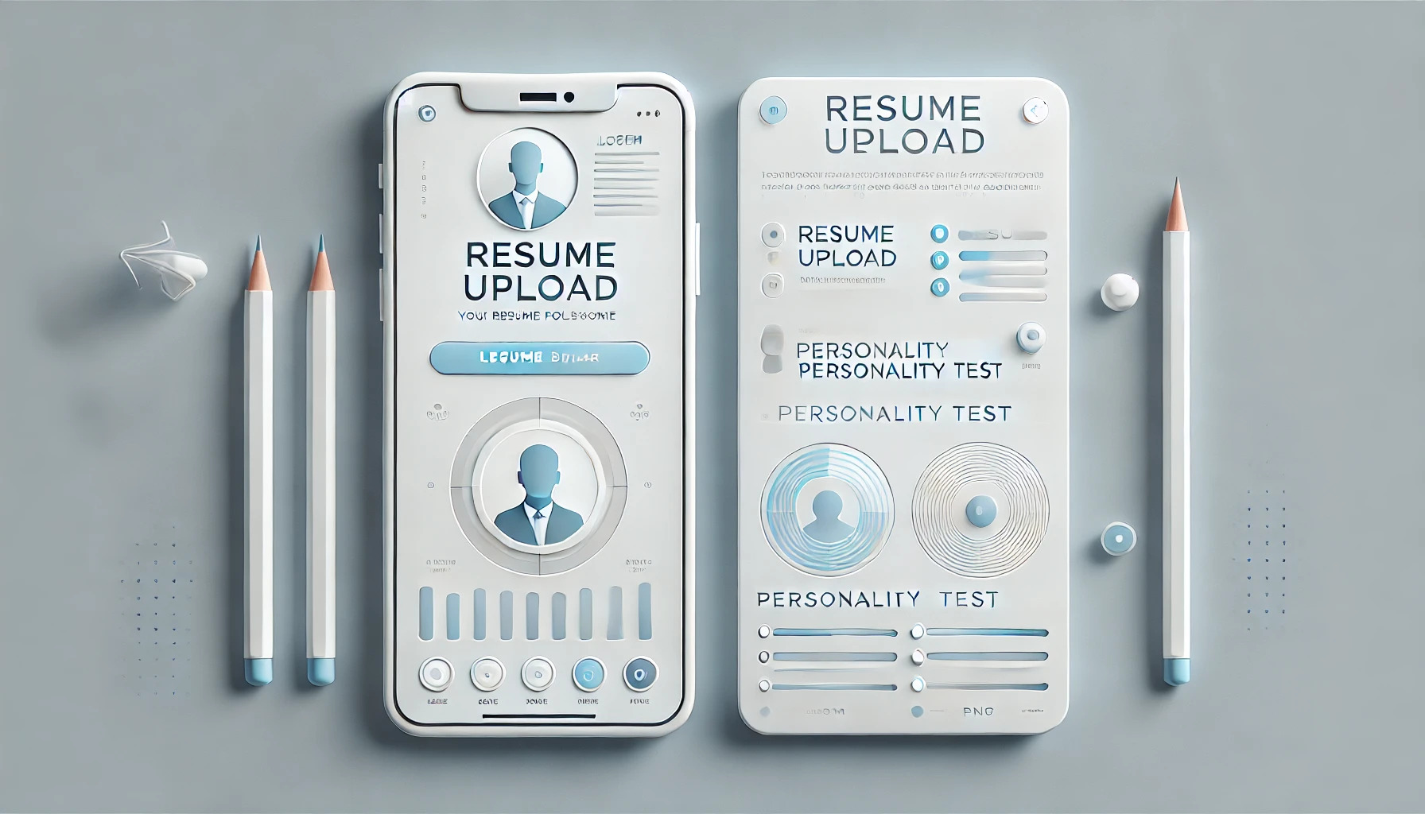
Persona Predictors
Personality Recognition Via CV Analysis

Slide 2
Software Components
Frontend
Technology: React.js
Pages:
Registration: User account creation.
Login: Secure authentication for users.
Personality Test: Captures user traits via an interactive test.
CV Upload: Facilitates resume submission for evaluation.
Backend
Technology: Java-based microservices architecture.
Key Features:
AuthService: Manages secure authentication.
Acts as the bridge between:
Frontend ↔ Database (via JPA).
Frontend ↔ Python Models (via microservices).

Slide 3
Software Components
Storage
Database: PostgreSQL
Purpose: Stores user details, test results, and uploaded CVs securely.
Models
Technology: Python
Functionality:
Evaluate success rate and user personality based on CVs and test data.
Model name:
Gemini - 1.5 - flash

Slide 4
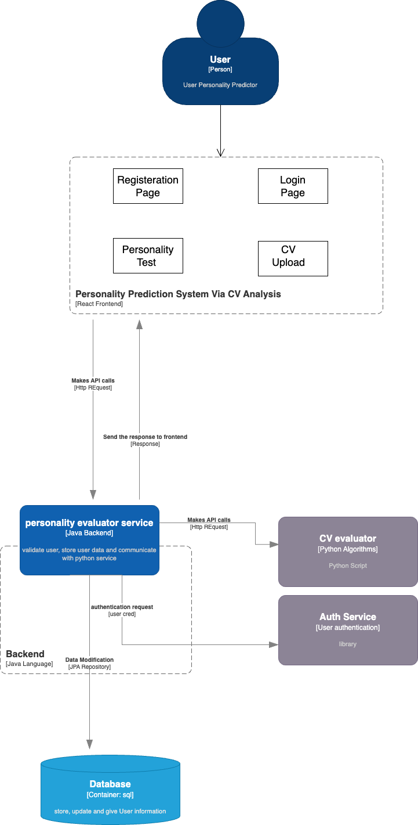
Project Architecture
For better view please visit the given link
https://drive.google.com/file/d/1yfju5SsTypDH9u2Qr7ClPv0-WUnHSbGG/view?usp=sharing

Slide 5
Team Members
Aditya Goyal
Elie Sakr
Harshit Tayal
Shabana Sheikh

